Slide 1
Cross-Platform Mobile Application Development
B.Sc. Web Technologies & Programming
Department of Computer Science & Applied Physics

Slide 2
Ionic - History
PhoneGap was created in 2009 as an open source way to access the “native” environment through a Web View in native app.
PhoneGap’s goal was to make it possible to build the bulk of a mobile app with pure web technologies like HTML5, CSS, and Javascript.

Slide 3
Ionic – History
In 2011 Adobe purchased PhoneGap and donated it to Apache Software Foundation under the name Cordova.
PhoneGap continued to be developed by Adobe, but is not open source.
Cordova is open source and maintained by a community of developers.

Slide 4
Ionic – History
Ionic uses Cordova, not PhoneGap.
Cordova uses an API to call Javascript functions that map to native code or plugins.
Camera, GPS and other OS features are accessible via plugins.

Slide 5
Ionic - History
Cordova provides APIs to access Native (OS) functions.
Native SDKs (Software Development Kits) provide much more UI components like navigation, interactions, views.
These aren’t provided by Cordova.

Slide 6
Ionic
“Ionic is a powerful HTML5 SDK that helps you build native-feeling mobile apps using web technologies like HTML, CSS, and Javascript.”
Focused on the “look and feel” of an app.
Uses HTML5, CSS and JavaScript.
Uses AngularJS to work to full potential

Slide 7
AngularJS
AngularJS is a structural framework for dynamic web apps.
Allows HTML to be extended.
Automatic data-binding.

Slide 8
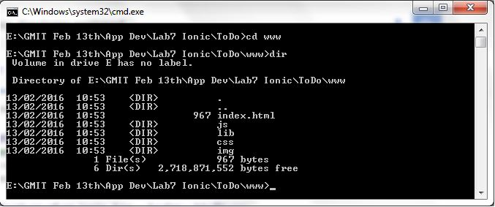
Ionic - Structure
index.html Your application’s UI
js The JavaScript code controlling your app
js/app.js Module Controller (used in AngularJS)
lib External libraries you need for your app
css CSS code
img Locally stored images to be displayed in your app

